Slide 1
Causes of Death
Investigating the Causes of Death before and after COVID-19
Presented by: Dardeep Somel
Non-technical Presentation

Slide 2

Dataset
Dataset: Death rates by cause of death (per 100,000 people) from 2017 to 2021.

Slide 3
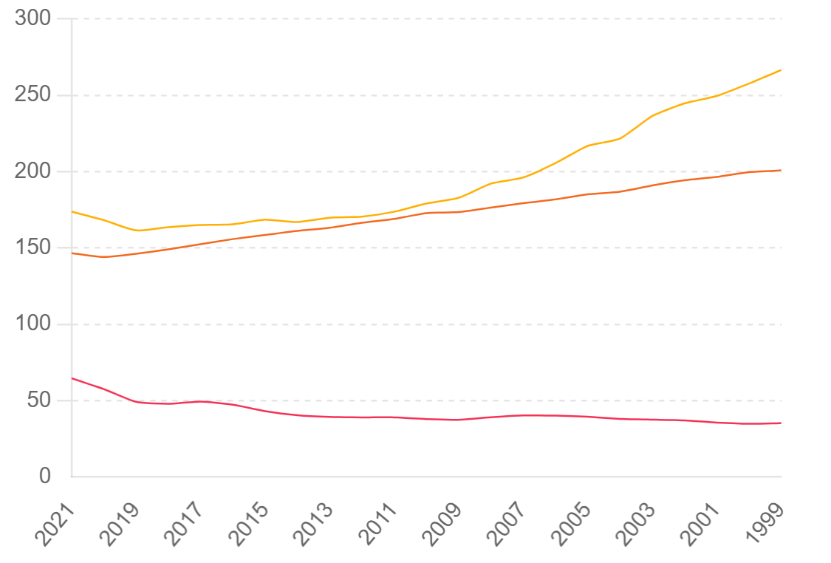
Purpose
To identify trends and significant increases/decreases in causes of deaths.
Review causes in 4 different categories

Slide 4
Categories
Cardiovascular Related Deaths
Infectious Disease Related Deaths
Neurological Conditions
Non-Medical Related Conditions

Slide 5
Impact of COVID-19
Underreporting: Potential underreporting of COVID-19 deaths reflected in increases across other causes.
Misclassification: Deaths from COVID-19 complications possibly recorded under causes like pneumonia, heart disease, etc.
Notes:
Within each of those Categories we want to ask ourselves a question. Has there been a significant change possibly an uptick in number of deaths which would hint towards covid-19 numbers being under reported.

Slide 6

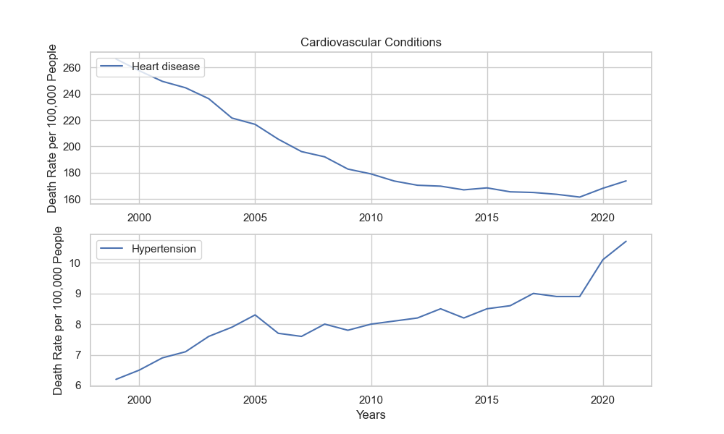
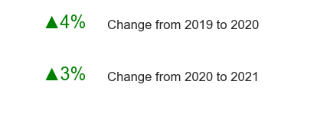
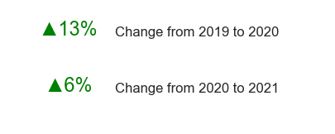
Cardiovascular
Heart Disease
Hypertension
Notes:
First Category we will focus on is Cardiovascular related deaths. In this category the 2 main causes of death care Heart Disease and Hypertension. These 2 are in a way categories of there own as Heart Disease more specifically Ischaemic heart diseases, can be anything from Angina pectoris or myocardial infarction. We can see over the years Death Rate per 100,000 people was on a consistent downward tread. This is great as modern medicine has been greatly improving our quality of life and we can see since even before 2000’s we have been seeing death rate go from 260 to around 160 in 2019. But then look what happened. In 2020 there was a jump, that downward trend changed to an upward, a 4% increase in 2020 from 2019 and 3% increase from 20202 to 2021. Hypertension related deaths we see it wasn’t always in a downward trend. In some cases YoY in 2006 and even around 2013 there were moments when it was decreasing, but if we zoom out and review death rate per 100,000 from 2000, it has been increasing. But in 2020 you will notice a 13% increase, this is a huge jump, Hypertension increase 13% in 2020 alone, if we look at the previous record it took nearly 8 years if you look at the graph you’ll see that increase from 2010 to 2018 ( that 8 year span) was equivalent to that of just 1 year in 2020.

Slide 7

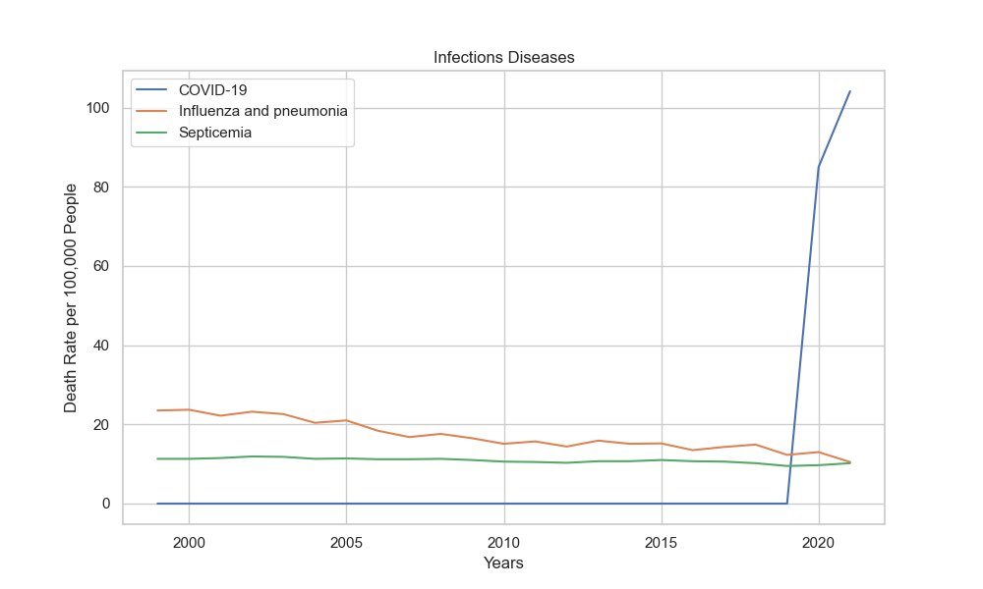
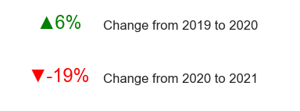
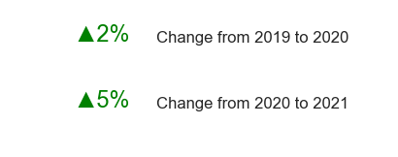
Infectious Disease
Influenza and Pneumonia
Septicemia
Notes:
Hre for Infectious disease we’ll review Influenza and pneumonia with the orange line and Septicemia with the green. One interesting thing is that Influenza cases have been consistently decreasing and further decreased in 2021. Many experts had mentioned this as the mask mandate had prevented the spread, as it has a lower contact rate than that of COVID-19. And Of course we will plot Covid-19 in this graph as it classifies as infectious disease. Septicemia has increased however reviewing the trend over the years there isn’t quite a noticeable change.

Slide 8

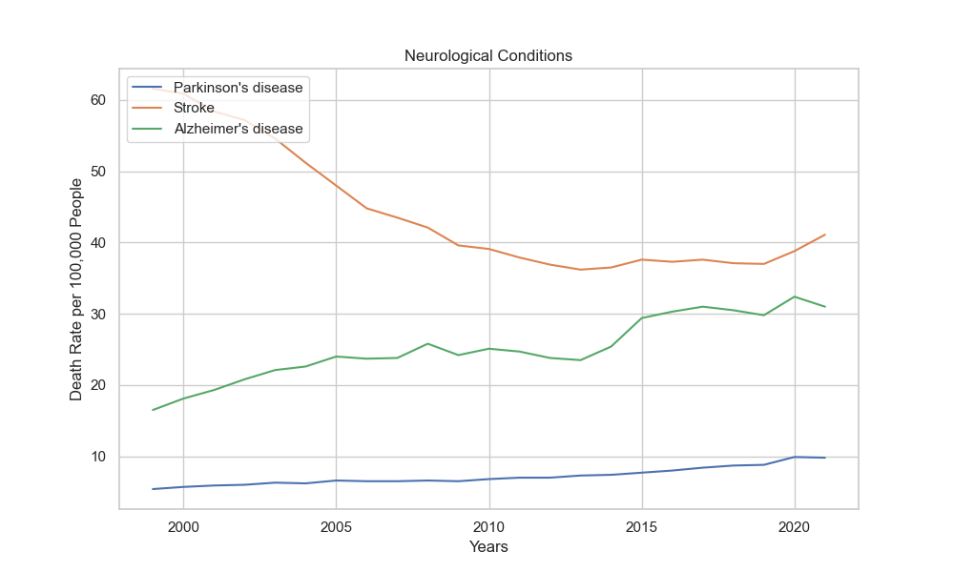
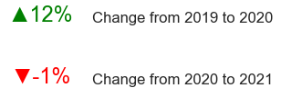
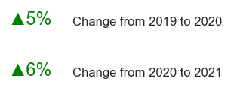

Neurological Conditions
Parkinson’s
Stroke
Alzheimer’s
Notes:
Strones have had the largest noticeable increase. This maybe due to misclassification but also due to medical/hospital constrains and individuals refusing to seek medical attention as there was a fear of visiting emergency units as they would be exposed to the Covid-19 Virus.
There maybe another case where these idividuals are at a higher risk of dying from the virus

Slide 9

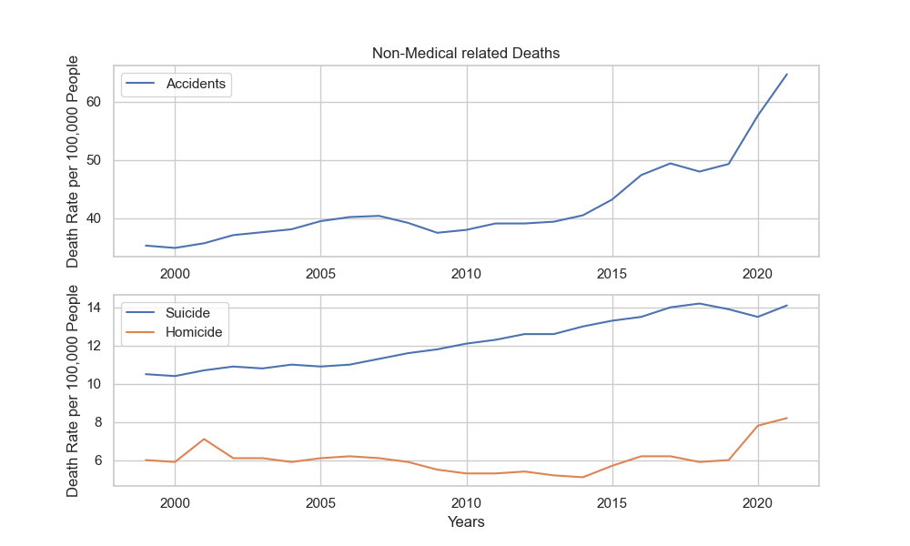
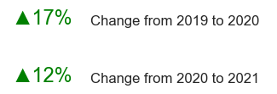
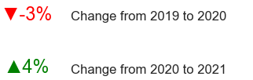
Non-medical related
Accidents
Suicide
Homicide
Notes:
This was byfar the most interesting data. Despite the workfrom home mandates, less drivers on the road. The most surprising detail is the death rate for Vehicle accidents. This detail I have to note that vehicle accidents do include at home lawnmowers and heavy workplace equipment accidents as well. But it does come at a surprise.
Another surprising detail is number of Suicides had decreased. While if you look at the years prior it was always increasing at a consistent rate and then a decrease. This maybe a whole other research to understand why this maybe the case so we won’t dive deep into this but isn’t this interesting?
And another just interesting detail… Homicides. Reached an all time high, while these items aren’t not to point out any suspicion for covid data misclassification, it is just an interesting observation.

Slide 10
Conclusion
Significant Impact: COVID-19 had a significant impact on death rates.
Need for Accurate Reporting: Ensuring correct classification of causes of death is crucial, especially during pandemics.
Further Research: Continued analysis required to understand the full impact.
Notes:
In conclusion we can determine there is Significant impact of Covid-19 and the impact on death rates, we cannot jump to conclusion that there was misclassification. But it does prove the need for accurate reporting and to ensure it was correct during the pandemics. With this further Research is required.

Slide 11
Questions & Answers
Open floor for questions and further discussion

